Slide 1
3D-SCANNERS
Presented By: Rishikesh More [712499013] Rushubah Shaha [712499014] Siddhant Shinde [712499017]

Slide 2
Introduction
3D scanners are devices that analyze real-world objects or environments to collect data on their shape and appearance (e.g., geometry, texture, and color).
The scanner captures this data and converts it into a digital 3D model, typically stored in file formats like STL (Stereolithography), OBJ, or PLY.
The STL file format is most commonly used in 3D printing and computer-aided design (CAD) because it represents the surface geometry of a 3D object using triangular facets.
STL files created from scanners can be edited in software like Blender, Mesh mixer, or SolidWorks, making them ideal for reverse engineering, rapid prototyping, or digital archiving.

Slide 3
Working of 3D-Scanners
Data Collection: The scanner sends out a beam of light (like a laser or structured light) or captures images (like in photogrammetry) of the object from multiple angles.
Surface Detection: The scanner detects how the light bounces off the object or how the pattern/image gets distorted on its surface. This helps it figure out the distance and position of each point on the object.
Point Cloud Creation: All these detected points are stored as a point cloud—a huge collection of XYZ coordinates that describe the surface geometry.
Mesh Generation: The point cloud is processed into a triangular mesh, which connects the dots to form the surface. This mesh is the actual 3D model.
Exporting the Model: The mesh is then saved in a standard 3D file format like STL, OBJ, or PLY. STL is the most common for 3D printing and editing.
Editing (Optional): The file can be opened in CAD or mesh-editing software like Blender, Meshmixer, or Fusion 360 to fix any holes, smooth the surface, or modify the design.

Slide 4
Types of 3D-Scanners
FreeScan UE Pro Series
FreeScan UE Pro Series
FreeScan Trio
FreeScan Trak ProW
FreeScan Trak Nova
FreeScan Trak Pro2
OptimScan Q12
OptimScan 5M Plus
EINSTAR

Slide 5
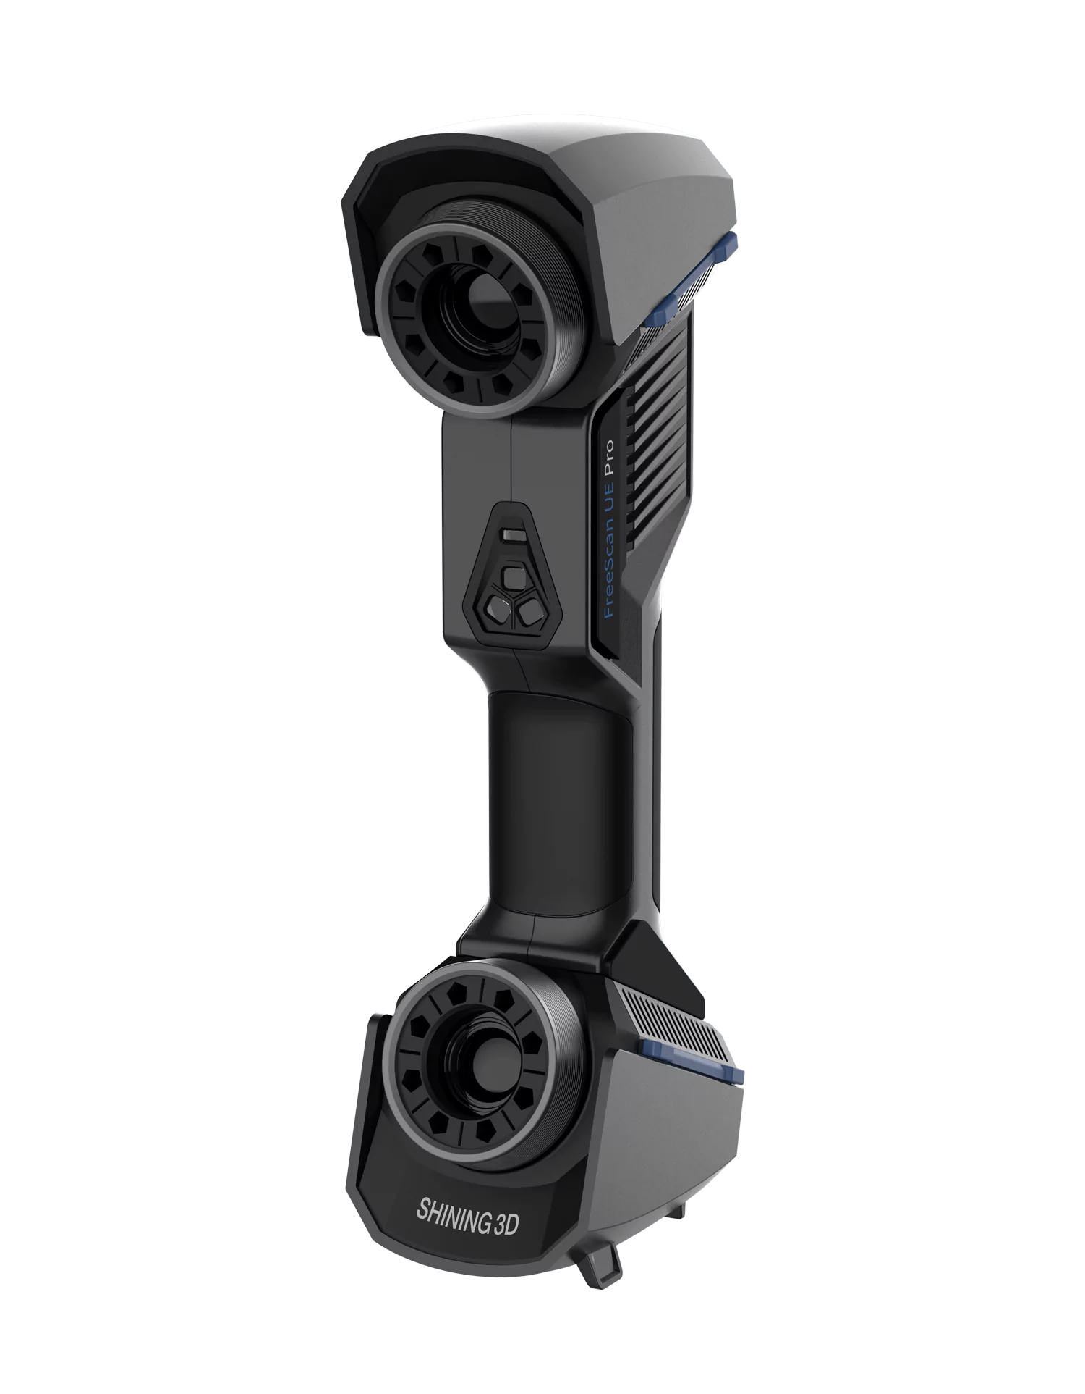
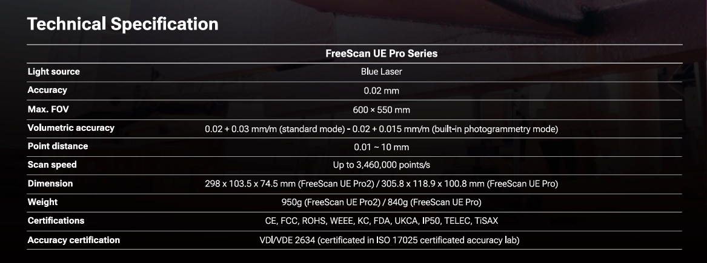
FreeScan UE Pro Series
Price = ₹ 15,00,000
Website :https://https://rev1tech.com/shop/3d-scanning/metrology-hardware/freescan-ue-pro/.com/shop/3d-scanning/metrology-hardware/freescan-ue-pro/

Slide 6
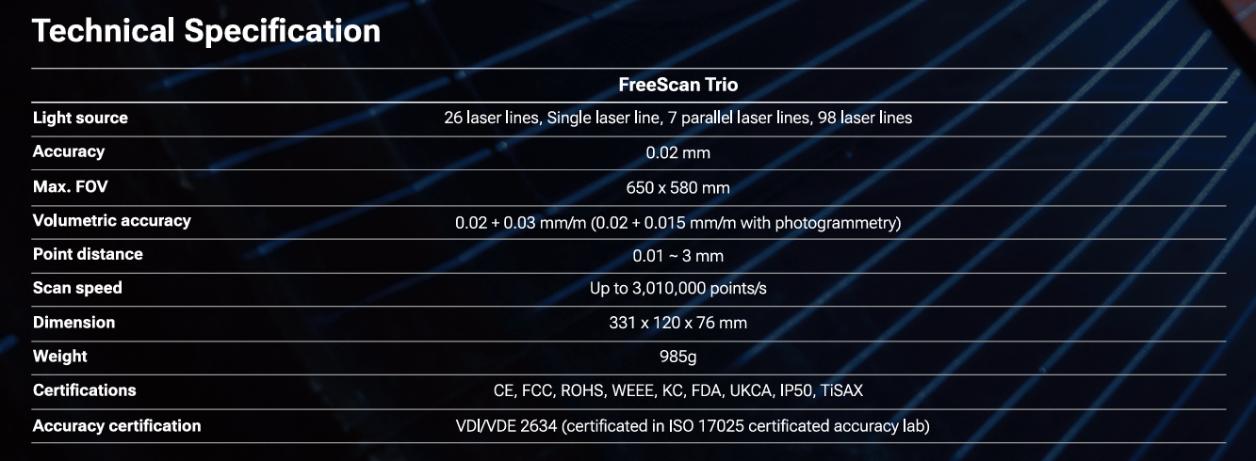
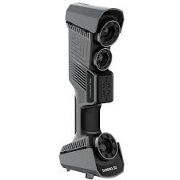
FreeScan Trio
Price = 30,10,000
https://rev1tech.com/shop/3d-scanning/metrology-hardware/freescan-trio/

Slide 7
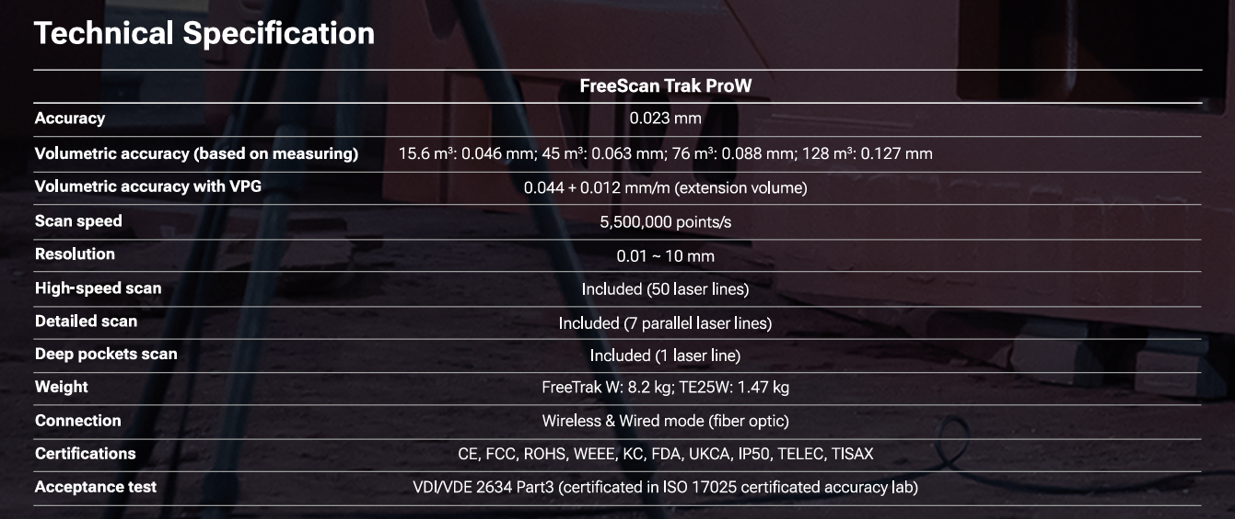
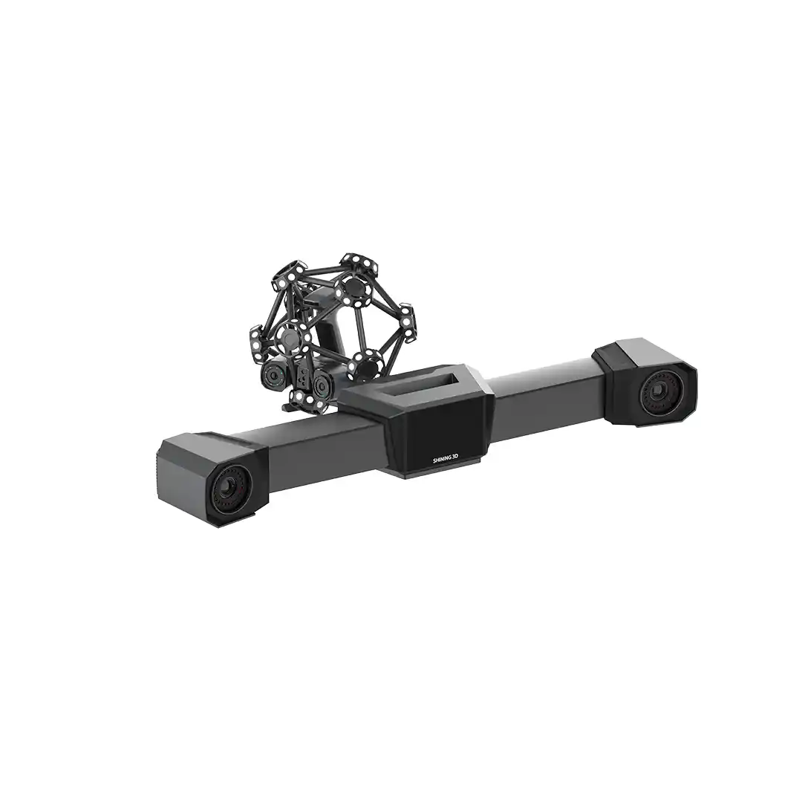
FreeSacn Trak ProW
Price = 4,80,000
Website : https://https://rev1tech.com/shop/3d-scanning/metrology-hardware/freescan-trak-prow/.com/shop/3d-scanning/metrology-hardware/freescan-trak-prow/

Slide 8
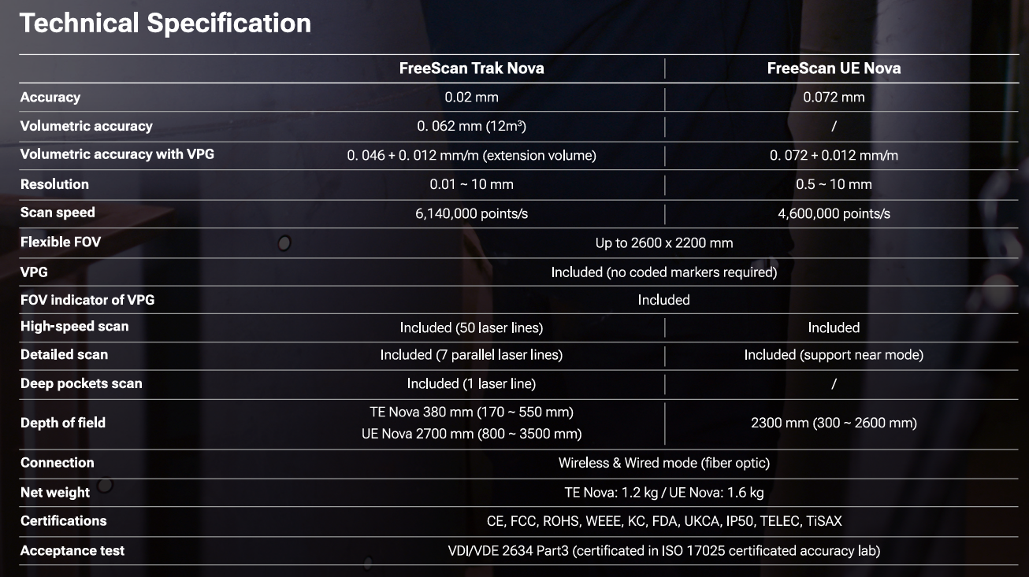
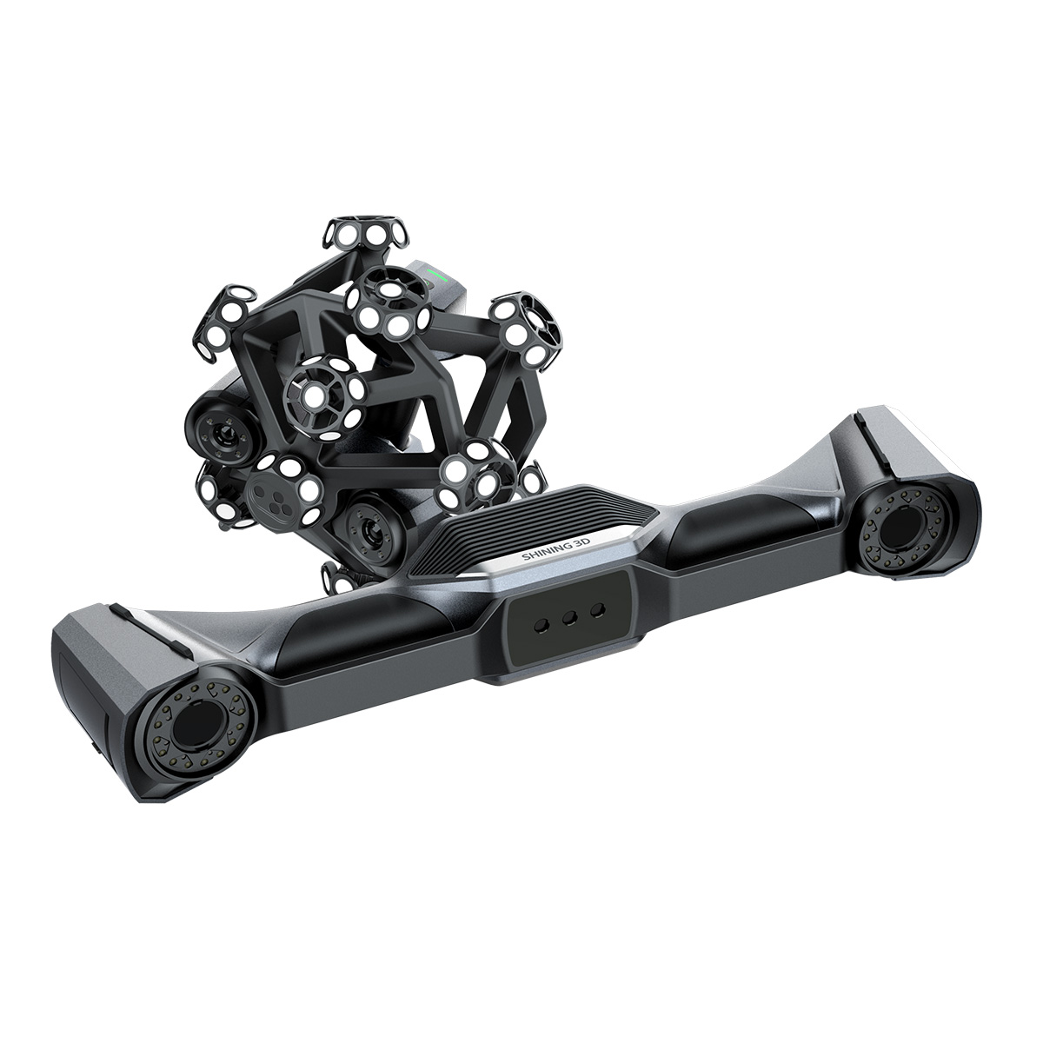
FreeSacn Trak Nova
Price = $1000
https://rev1tech.com/shop/3d-scanning/metrology-hardware/freescan-trak-nova/

Slide 9
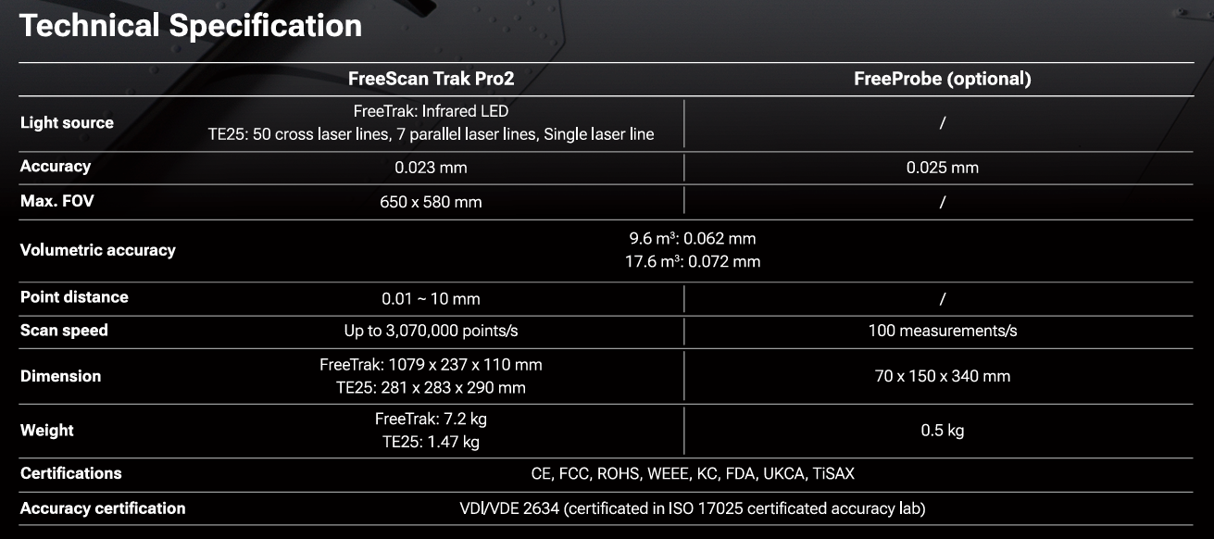
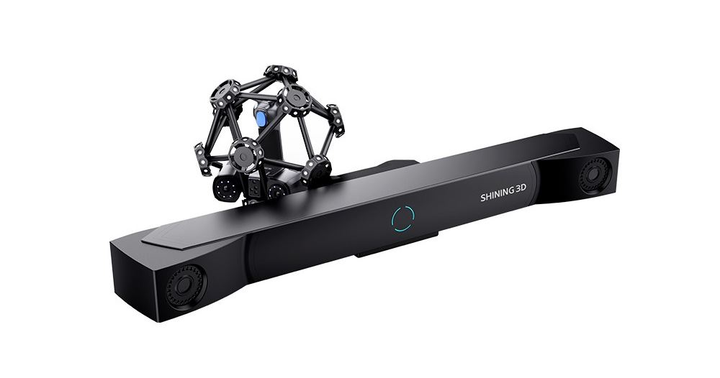
FreeSacn Trak Pro2
Price = $92,500
https://rev1tech.com/shop/3d-scanning/metrology-hardware/freescan-trak-pro2/

Slide 10
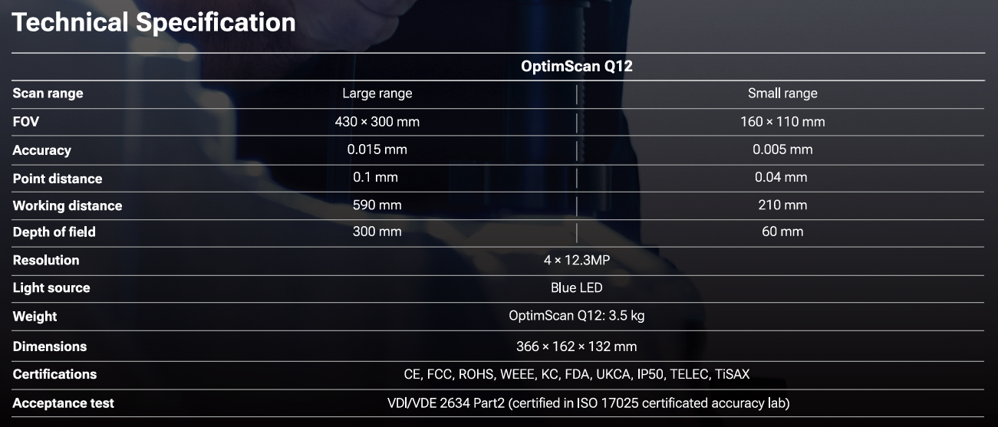
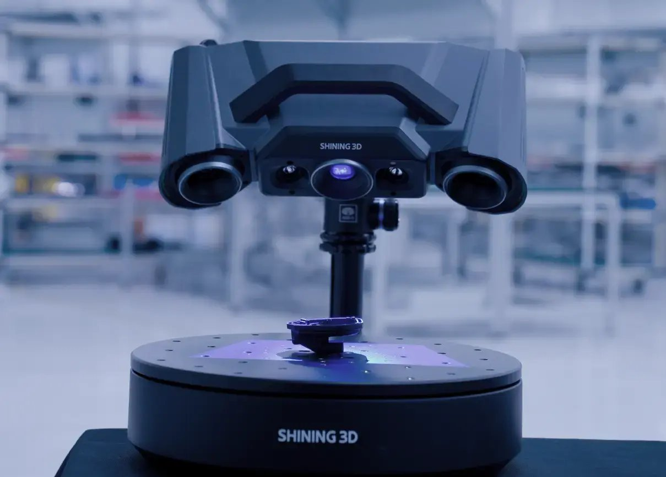
OptimScan Q12
₹
Price = $1000
https://rev1tech.com/shop/3d-scanning/metrology-hardware/https://rev1tech.com/shop/3d-scanning/metrology-hardware/optimscan-q12//

Slide 11
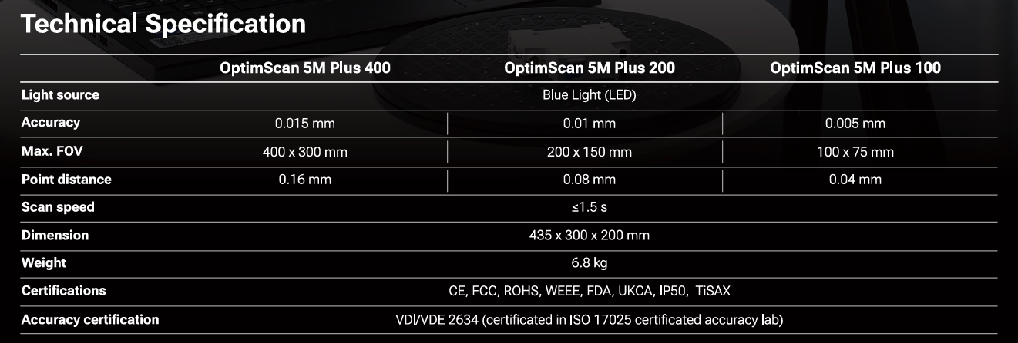
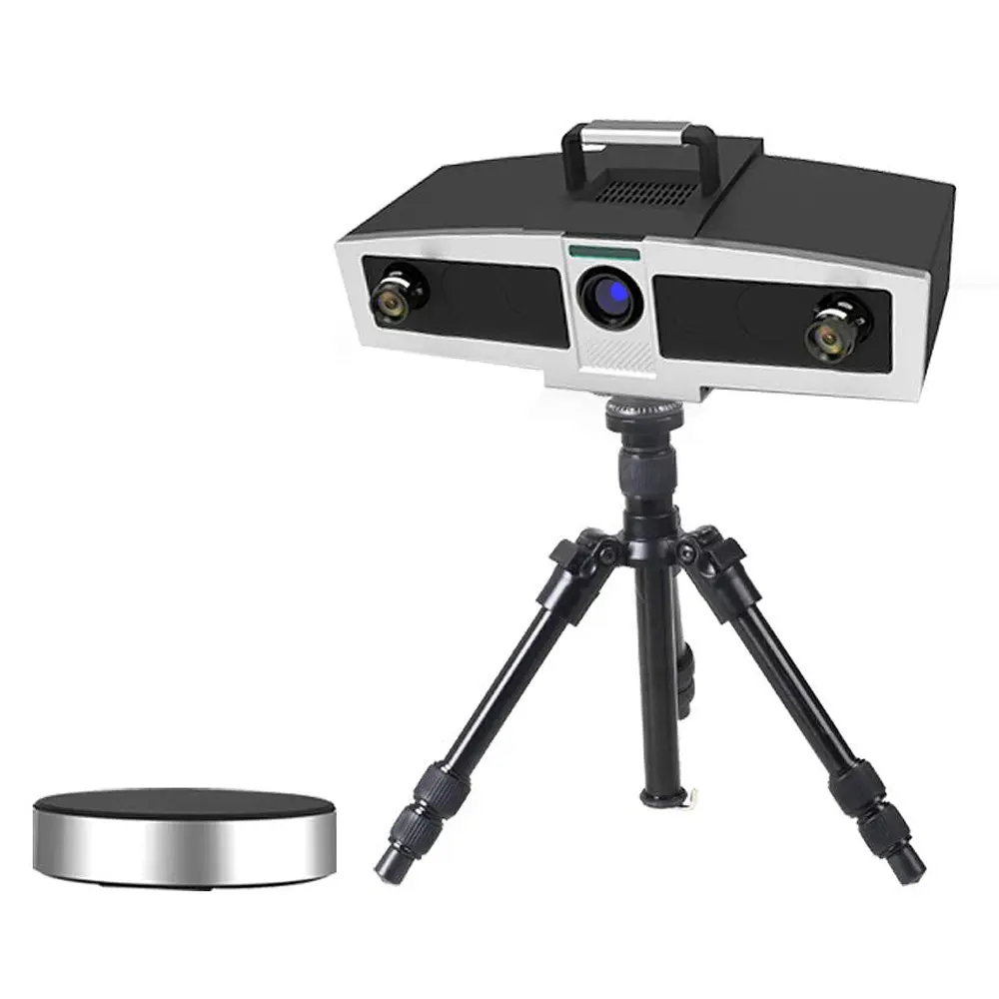
OptimScan 5M Plus
Price = $1000
https://rev1tech.com/shop/3d-scanning/metrology-hardware/https://rev1tech.com/shop/3d-scanning/metrology-hardware/optimscan-5m-plus//

Slide 12
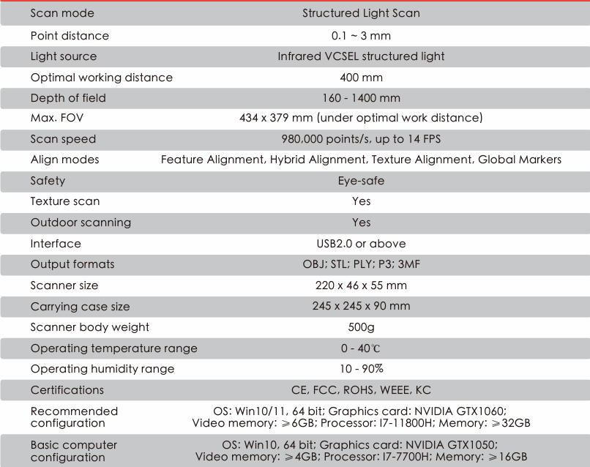
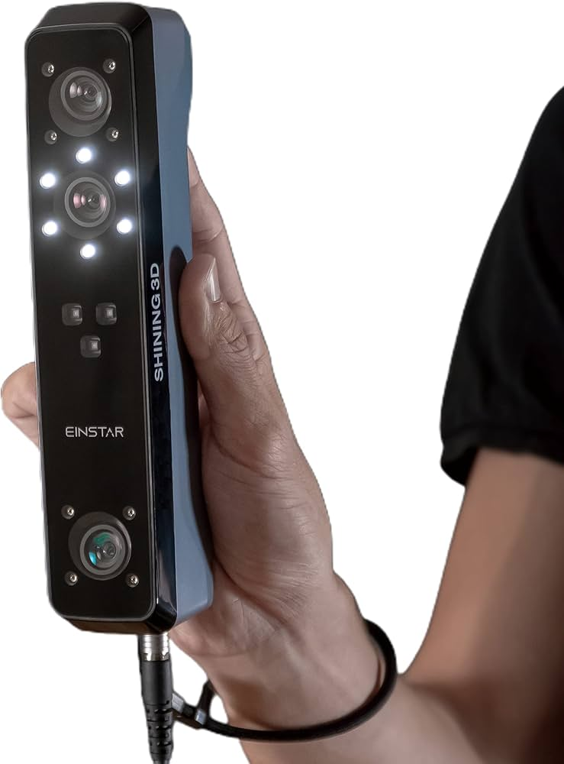
EINSTAR
Price = ₹ 1,25,000
https://rev1tech.com/shop/3d-scanning/einstar/

Slide 13
Feature | FreeScan UE Pro Series | FreeScan Trio | FreeScan Trak ProW | FreeScan Trak Nova | FreeScan UE Nova | FreeScan Trak Pro2 | OptimScan Q12 | OptimScan 5M Plus
Light Source | Blue Laser | 26/1/7/98 laser lines | Infrared LED (Trak) + TE25 lasers | TE Nova / UE Nova lasers | Not listed | TE25: cross/parallel/single lasers | Blue LED; 4 ×12.3 MP cameras | Blue LED
Accuracy | 0.02 mm | 0.02 mm | 0.023 mm | 0.02 mm | 0.072 mm | 0.023 mm | Large: 0.015 mm; Small: 0.005 mm | 0.015 / 0.01 / 0.005 mm
Volumetric Accuracy | 0.02+0.03 mm/m (std); 0.02+0.015 mm/m (photo) | 0.02+0.03 mm/m (std); 0.02+0.015 mm/m (photo) | VPG: 0.044+0.012 mm/m | Nova: 0.046+0.012 mm/m (12 m³) | 0.072+0.012 mm/m | 0.062 mm @9.6 m³; 0.072 mm @17.6 m³ | — | —
Max FOV | 600×550 mm | 650×580 mm | — | Up to 2600×2200 mm | — | 650×580 mm | 430×300 mm / 160×110 mm | 400×300 / 200×150 / 100×75 mm
Point Distance / Resolution | 0.01–10 mm | 0.01–3 mm | 0.01–10 mm | 0.01–10 mm | 0.5–10 mm | 0.01–10 mm | 0.1 mm / 0.04 mm | 0.16 / 0.08 / 0.04 mm
Scan Speed | Up to 3.46 M pts/s | Up to 3.01 M pts/s | 5.5 M pts/s | 6.14 M pts/s | 4.6 M pts/s | Up to 3.07 M pts/s | — | ≤1.5 s per scan
Special Modes | Photogrammetry mode | Photogrammetry mode | High-speed (50 lines), detailed (7), deep (1) | High-speed, detailed, deep | High-speed, detailed | — | Large/small range optics | —
Working Distance / Depth of Field | — | — | — | TE Nova: 170–550 mm; UE Nova: 800–3500 mm | 2300 mm (300–2600 mm) | — | WD: 590 mm (large) / 210 mm (small) | —
Weight | 840 g (Pro), 950 g (Pro2) | 985 g | FreeTrak: 8.2 kg; TE25W: 1.47 kg | TE Nova: 1.2 kg; UE Nova: 1.6 kg | — | FreeTrak: 7.2 kg; TE25: 1.47 kg | 3.5 kg | 6.8 kg
Dimensions (mm) | 298×103.5×74.5 (Pro2); 305.8×118.9×100.8 (Pro) | 331×120×76 | FreeTrak: 1079×237×110; TE25: 281×283×290 | — | — | Same as Trak ProW/TE25 | 366×162×132 | 435×300×200
Certifications | CE, FCC, ROHS, WEEE, KC, FDA, UKCA, IP50, TELEC, TiSAX | same | same | same | same | same | same | same
Accuracy Certification | VDI/VDE 2634 (ISO 17025) | VDI/VDE 2634 (ISO 17025) | VDI/VDE 2634 Part 3 (ISO 17025) | VDI/VDE 2634 Part 3 | same | VDI/VDE 2634 (ISO 17025) | VDI/VDE 2634 Part 2 | VDI/VDE 2634 (ISO 17025)

Slide 14
Comparison of 3D Scanning Technologies
This document compares three common light-based technologies used in 3D scanners: Infrared (IR), VCSEL Laser (UE Nova-style), and Blue LED. The comparison is based on technical criteria and use-case performance in 3D scanning applications.
Ranking for 3D Scanning Applications
1st - VCSEL Laser (UE Nova-style / Time-of-Flight): Highest accuracy, best surface handling, works in all lighting.
2nd - Infrared (IR): Cost-effective, decent quality, but struggles with glossy/transparent objects.
3rd - Blue LED: Suitable in controlled environments, weak in ambient or real-world settings.

Slide 15
Technical Comparison Table
Parameter | Infrared (IR) | VCSEL Laser | Blue LED
Accuracy / Resolution | Medium | Very High | Medium
Depth Range | Medium (~1-3 m) | High (~5 m+) | Low (<1 m)
Surface Compatibility | Poor with shiny/transparent | Better performance | Poor with dark/shiny
Eye Safety | Safe (Class 1) | Safe (Class 1) | Safe
Lighting Conditions | Works in dark/light | Best in all conditions | Affected by ambient light
Speed | Medium | Fastest | Slow
Power Consumption | Low | Medium to High | Medium
Cost | Low | High | Medium
Integration in Devices | Easy | Optimized | Less optimal

Slide 16
Conclusion
Scanner | Performance | Accuracy & Features | Ease of Use | Cost-Effectiveness | Overall Rating (/10)
FreeScan UE Pro | ★★★★☆ | 4.5/5 | 4.7/5 | High | 8.5
FreeScan Trio | ★★★★★ | 5.0/5 | 4.8/5 | Medium-High | 8.2
FreeScan Trak ProW | ★★★★★ | 5.0/5 | 4.5/5 | Expensive | 7.8
FreeScan Trak Nova | ★★★★☆ | 4.8/5 | 4.6/5 | Moderate | 8.0
FreeScan Trak Pro2 | ★★★★★ | 5.0/5 | 4.6/5 | High | 8.1
FreeScan UE Nova | ★★★★☆ | 4.6/5 | 4.6/5 | Not disclosed | 8.0 (Est.)
OptimScan Q12 | ★★☆☆☆ | 3.0/5 | 4.0/5 | Very High | 6.5
OptimScan 5M Plus | ★★★★☆ | 4.8/5 | 4.3/5 | Mid-High | 7.8
FreeScan UE Pro Series:
Great balance between price and professional performance
Suitable for industrial tasks like reverse engineering, quality inspection
Lightweight, easy to use, and reliable
Comes at a lower cost (~₹1.3–₹8.2 L) than high-end scanners, but delivers high-end accuracy (~0.02mm)

Slide 17
Creality 3D Scanners
Raptor & Raptor Pro
RaptorX
Creality Otter Lite
CR-Scan Ferret SE 3D Scanner
CR-Scan Lizard 3D Scanner

Slide 18
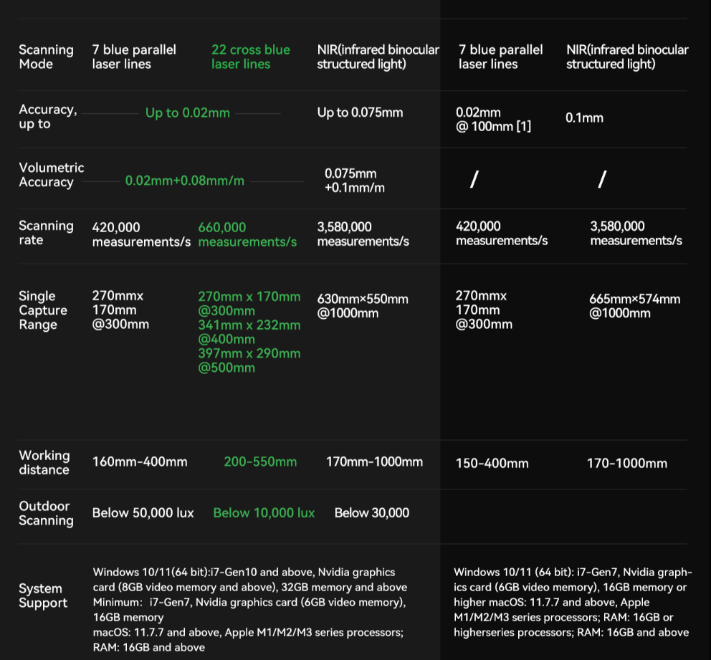
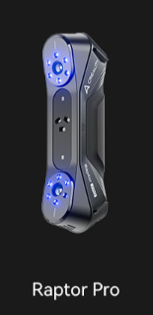
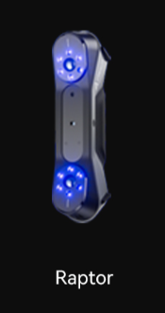
Raptor & Raptor Pro
Price = 4,00,000
https://store.creality.com/products/creality-raptor-pro-3d-scanner?official-website-pro-list=&spm=..page_11974337.products_display_1.1&spm_prev=..index.header_1.1

Slide 19
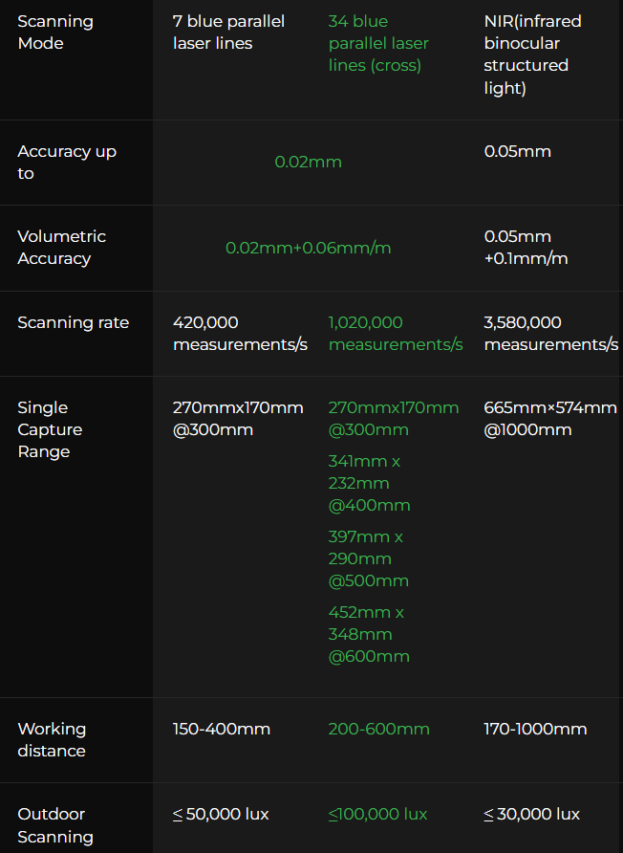
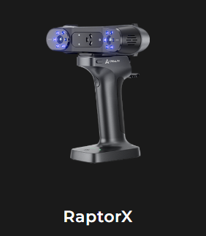
RaptorX
Price = ₹ 4,85,799
https://store.creality.com/products/creality-raptorx?official-website-pro-list=&spm=..page_11974337.products_display_1.1&spm_prev=..index.header_1.1

Slide 20
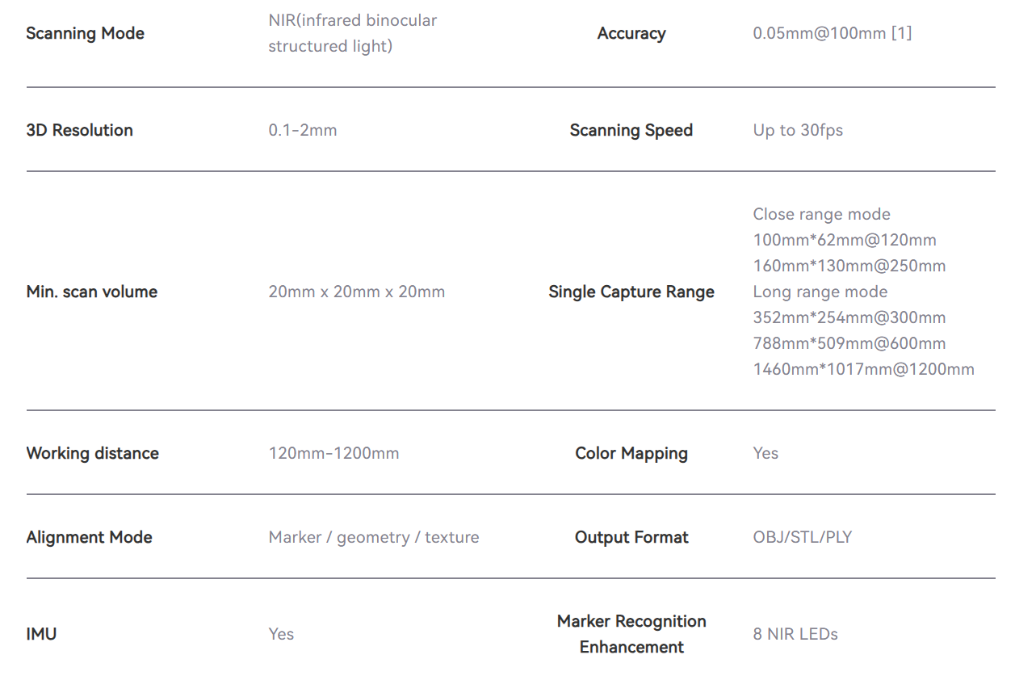
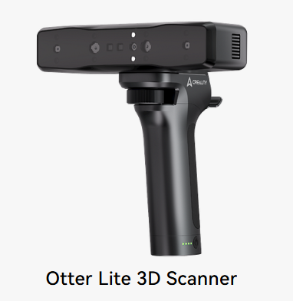
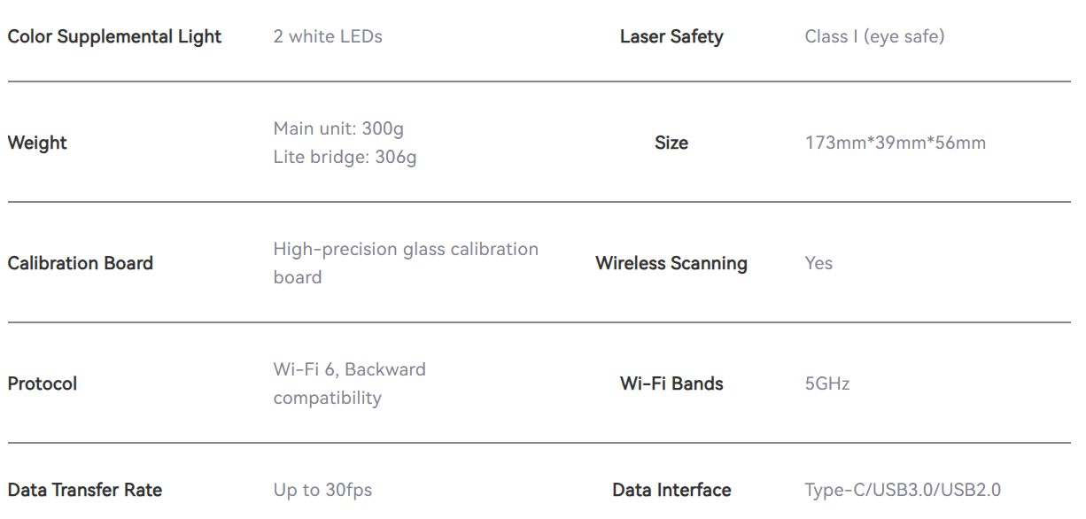
Creality Otter Lite
Price = ₹96,999
https://store.creality.com/products/otter-lite-3d-scanner?spm=..page_11974337.products_display_1.1&spm_prev=..index.header_1.1

Slide 21
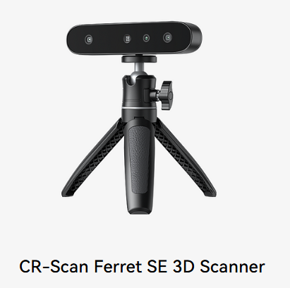
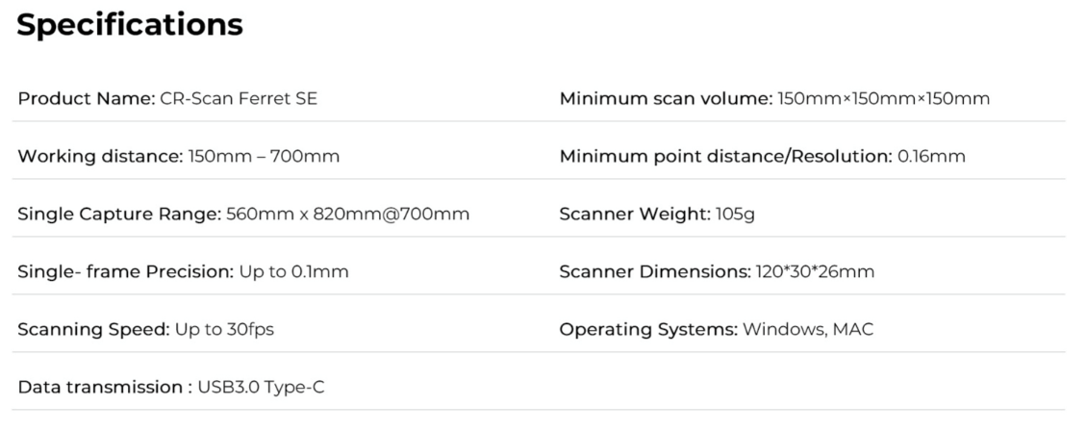
CR-Scan Ferret SE 3D Scanner
Price = ₹ 31,999
https://store.creality.com/products/cr-scan-ferret-se-3d-scanner?offcial-website-list-pro=&spm=..page_11974337.products_display_1.1&spm_prev=..index.header_1.1

Slide 22
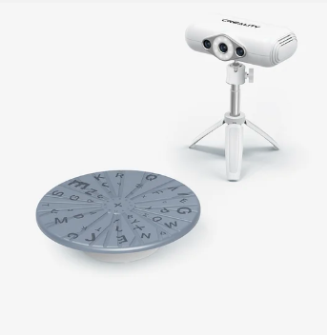
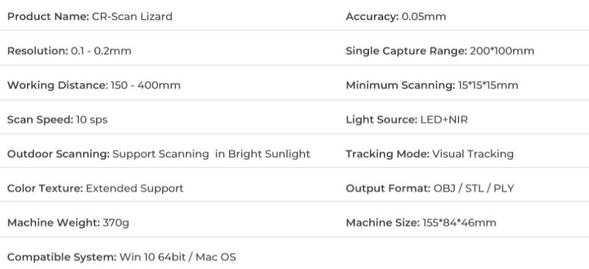
CR-Scan Lizard 3D Scanner
Price = ₹ 59,999
https://www.creality.com/products/creality-cr-scan-lizard-3d-scanner?spm=..page_11974337.products_display_1.1&spm_prev=..index.header_1.1

Slide 23
Feature | Raptor | Raptor Pro | RaptorX | Creality OtterLite | CR-Scan Ferret SE | CR-Scan Lizard
Scanning Mode | 7 Blue Laser Lines | 22/34 Blue Laser Lines (Cross) | NIR (Infrared Structured Light) | NIR (Infrared Structured Light) | NIR (Infrared Structured Light) | LED + NIR
Accuracy (up to) | 0.02 mm | 0.02 mm | 0.05–0.075 mm | 0.05 mm @ 100mm | 0.1 mm | 0.05 mm
Volumetric Accuracy | 0.02 mm + 0.08 mm/m | 0.02 mm + 0.06 mm/m | 0.05–0.075 mm + 0.1 mm/m | Not specified | Not specified | Not specified
Scanning Rate | 420,000 measurements/s | 660,000–1,020,000 measurements/s | 3,580,000 measurements/s | Up to 30 fps | Up to 30 fps | 10 sps
Single Capture Range | 270×170 mm @300mm | Up to 452×348 mm @600mm | Up to 665×574 mm @1000mm | Up to 1460×1017 mm @1200mm | 560×820 mm @700mm | 200×100 mm
Working Distance | 160–400 mm | 200–600 mm | 170–1000 mm | 120–1200 mm | 150–700 mm | 150–400 mm
Outdoor Scanning | < 50,000 lux | < 100,000 lux | < 30,000 lux | Supported | Supported | Supported (in bright sunlight)
Minimum Scan Volume | Not specified | Not specified | Not specified | 20×20×20 mm | 150×150×150 mm | 15×15×15 mm
Resolution | Not specified | Not specified | 0.1–2 mm | 0.1–2 mm | 0.16 mm | 0.1–0.2 mm
Color Mapping | No | No | No | Yes | Not mentioned | Extended support
Weight | Not mentioned | Not mentioned | Not mentioned | 300g (scanner), 306g (bridge) | 105g | 370g
Dimensions | Not specified | Not specified | Not specified | 173×39×56 mm | 120×30×26 mm | 155×84×46 mm
Wireless Support | No | No | No | Yes (Wi-Fi 6) | No | No
OS Compatibility | Windows/macOS | Windows/macOS | Windows/macOS | Windows/macOS | Windows/macOS | Win 10 (64-bit) / macOS
Output Formats | Not specified | Not specified | Not specified | OBJ / STL / PLY | Not specified | OBJ / STL / PLY
Tracking Mode | Not mentioned | Not mentioned | Not mentioned | Marker/geometry/texture | Not mentioned | Visual Tracking
Price Range (est.) | High-end (industrial use) | High-end (industrial use) | High-end (industrial use) | Mid-range consumer | Entry-level | Entry to mid-level

Slide 24
Conclusion [Creality 3D Scanners]
Scanner | Performance | Accuracy & Features | Ease of Use | Cost-Effectiveness | Overall Rating (/10)
Raptor | ★★★★☆ | 4.6/5 | 4.5/5 | High | 8.1
Raptor Pro | ★★★★★ | 5.0/5 | 4.7/5 | Medium-High | 8.4
RaptorX | ★★★★☆ | 4.8/5 | 4.6/5 | Moderate | 8.0
Creality OtterLite | ★★★☆☆ | 3.8/5 | 4.3/5 | Very High | 7.0
CR-Scan Ferret SE | ★★★☆☆ | 3.5/5 | 4.2/5 | Very High | 6.8
CR-Scan Lizard | ★★★★☆ | 4.6/5 | 4.4/5 | High | 7.9
Creality CR-Scan Lizard:
Budget-friendly: Priced around ₹50,000–₹80,000
Good accuracy (~0.05 mm), suitable for DIY, education, product design, and semi-pro use
No markers required, easy to set up and operate
Compatible with standard CAD and 3D printing software
Lightweight, portable, and USB-powered
AI-based texture and alignment support

Slide 25
Thank You!

